Slide 1


Mansoura University Faculty of Computers and Information Department of Computer Science Second Semester- 2025-2026
Software Project Management
Lab 5
Basma Yasser

Slide 2
Outlines
Techniques to Assess Value and Risks.
Payback.
Return on Investment (ROI).
Net Present Value (NPV).

Slide 3
Techniques to Assess Value and Risks
Diﬀerent techniques are available to assess the value and risk generated by a project. Some are based on ﬁnancial considerations, while others are more qualitative. Next, we present some of the most used techniques.​
Financial Methods:
Payback, Return on Investment (ROI), and Net Present Value (NPV).

Slide 4
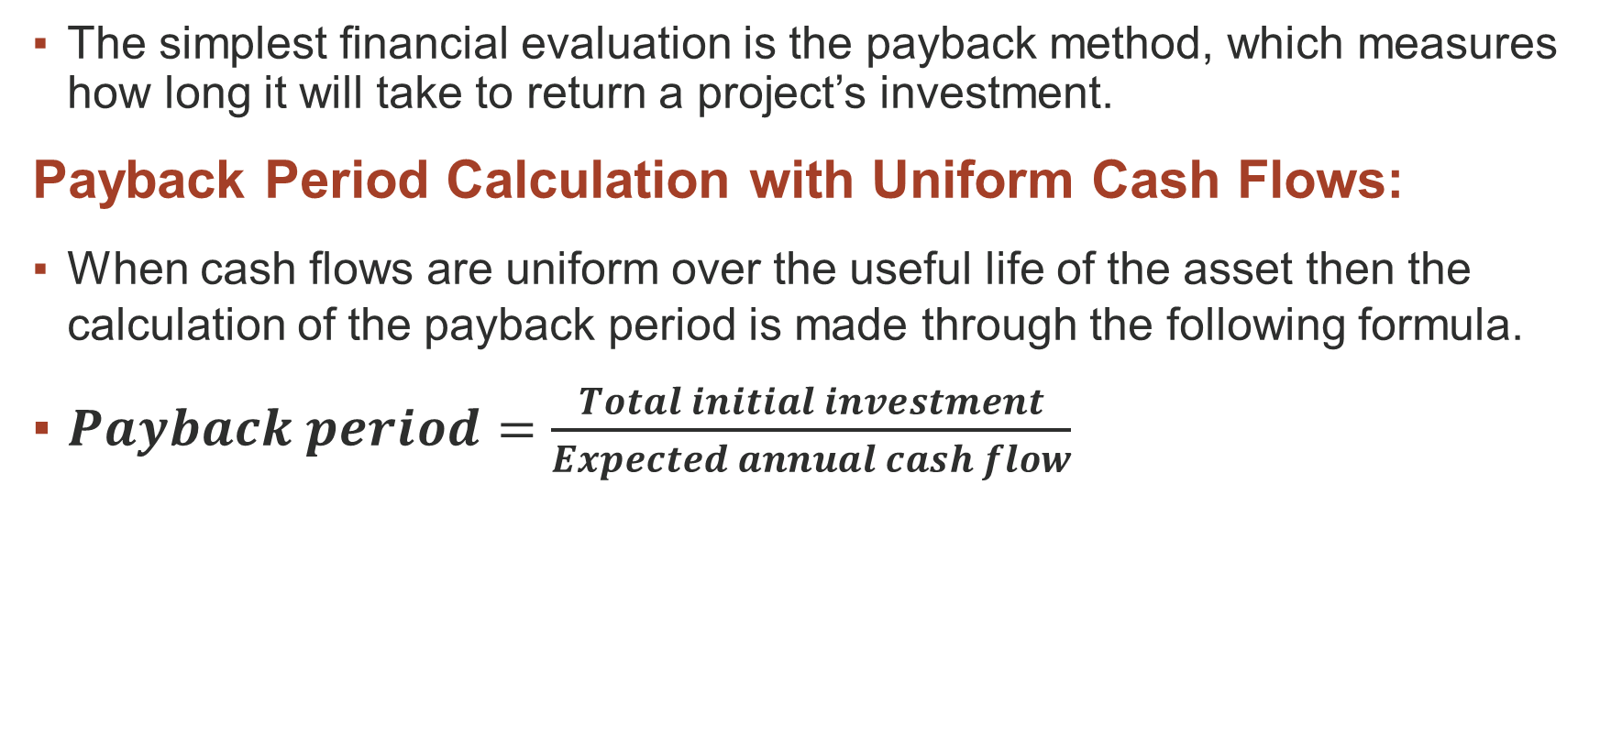
Payback
The simplest ﬁnancial evaluation is the payback method, which measures how long it will take to return a project’s investment.
Payback Period Calculation with Uniform Cash Flows​:
When cash flows are uniform over the useful life of the asset then the calculation of the payback period is made through the following formula.​
$Payback period=\frac{Total initial investment}{Expected annual cash flow}$

Slide 5
Payback
Example:
The Delta company is planning to purchase a machine known as machine X. Machine X would cost $25,000 and would have a useful life of 10 years. The expected annual cash inflow of the machine is $10,000.​
Compute payback period of machine X and conclude whether or not the machine would be purchased if the maximum desired payback period of Delta company is 3 years​.
Solution:
Payback period = $25,000/$10,000= 2.5 years.
According to payback period analysis, the purchase of machine X is desirable because its payback period is 2.5 years which is shorter than the maximum payback period of the company.​

Slide 6
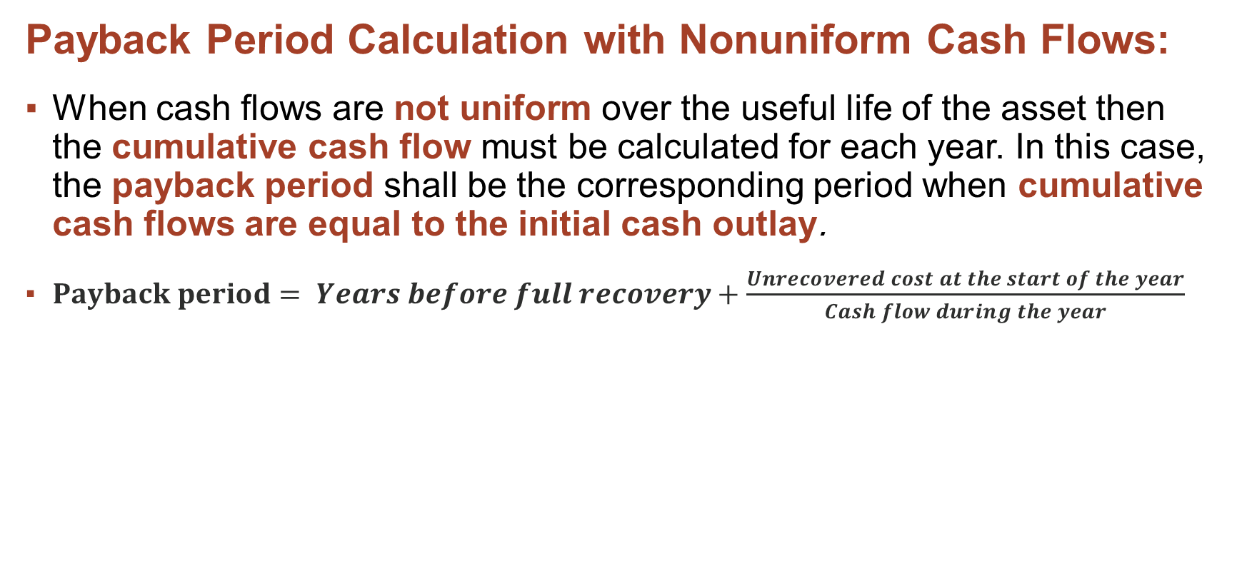
Payback
Payback Period Calculation with Nonuniform Cash Flows​:
When cash flows are not uniform over the useful life of the asset then the cumulative cash flow must be calculated for each year. In this case, the payback period shall be the corresponding period when cumulative cash flows are equal to the initial cash outlay.
$Payback period= Years before full recovery+\frac{Unrecovered cost at the start of the year}{Cash flow during the year}$

Slide 7
Payback
Example:
Suppose a particular company is analyzing a project which requires an investment of $200,000 and it is expected to generate cash flows as follows:​​
Year | Annaul cash inflow
1 | 80,000
2 | 60,000
3 | 60,000
4 | 20,000

Slide 8
Payback
Payback period can be calculated as follows by calculating cumulative cash flows:
Year | Annaul cash inflow | Cumulative annual cash inflows | Payback period
1 | 80,000 | 80,000
2 | 60,000 | 140,000
3 | 60,000 | 200,000
4 | 20,000 | 220,000

Slide 9
Payback
Payback period can be calculated as follows by calculating cumulative cash flows:
Year | Annaul cash inflow | Cumulative annual cash inflows | Payback period
1 | 80,000 | 80,000
2 | 60,000 | 140,000
3 | 60,000 | 200,000 | In this year we got an initial investment of $200,000, so this is the payback year​
4 | 20,000 | 220,000

Slide 10
Payback
Suppose the cash outlay is $205,000, then the payback period is:
Year | Annaul cash inflow | Cumulative annual cash inflows | Payback period
1 | 80,000 | 80,000
2 | 60,000 | 140,000
3 | 60,000 | 200,000
4 | 20,000 | 220,000 | Between 3 and 4 years

Slide 11
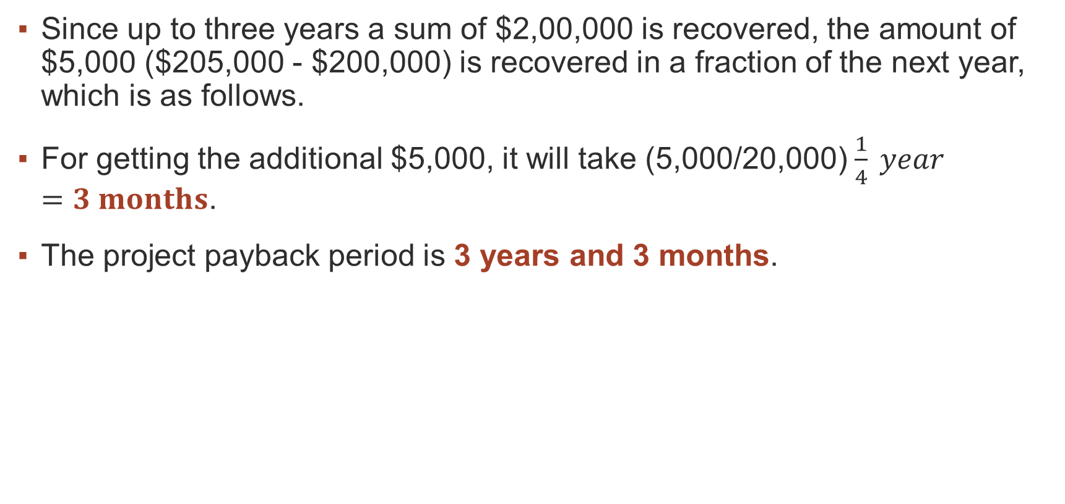
Payback
Since up to three years a sum of $2,00,000 is recovered, the amount of $5,000 ($205,000 - $200,000) is recovered in a fraction of the next year, which is as follows.
For getting the additional $5,000, it will take (5,000/20,000) $\frac{1}{4} year=3 months$.
The project payback period is 3 years and 3 months.​

Slide 12
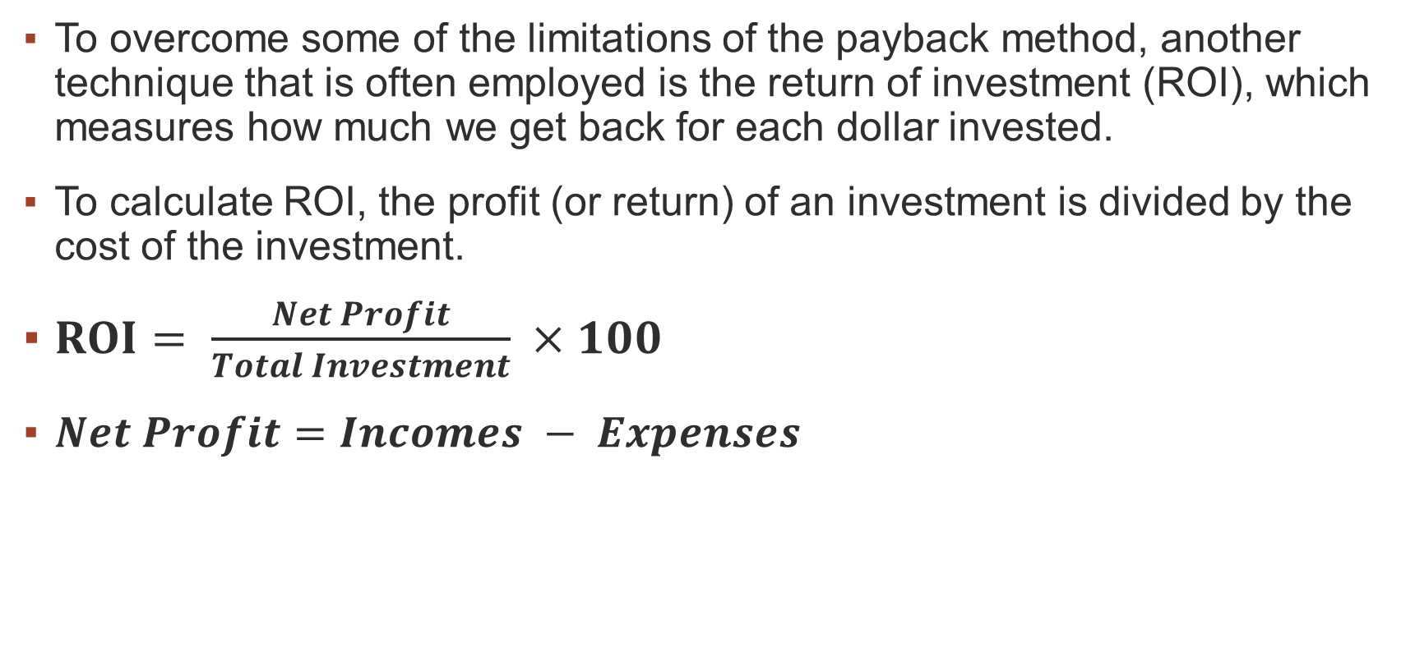
Return on Investment (ROI)
To overcome some of the limitations of the payback method, another technique that is often employed is the return of investment (ROI), which measures how much we get back for each dollar invested.
To calculate ROI, the profit (or return) of an investment is divided by the cost of the investment.
$ROI= \frac{Net Profit}{Total Investment} ×100$
$Net Profit=Incomes − Expenses$​

Slide 13
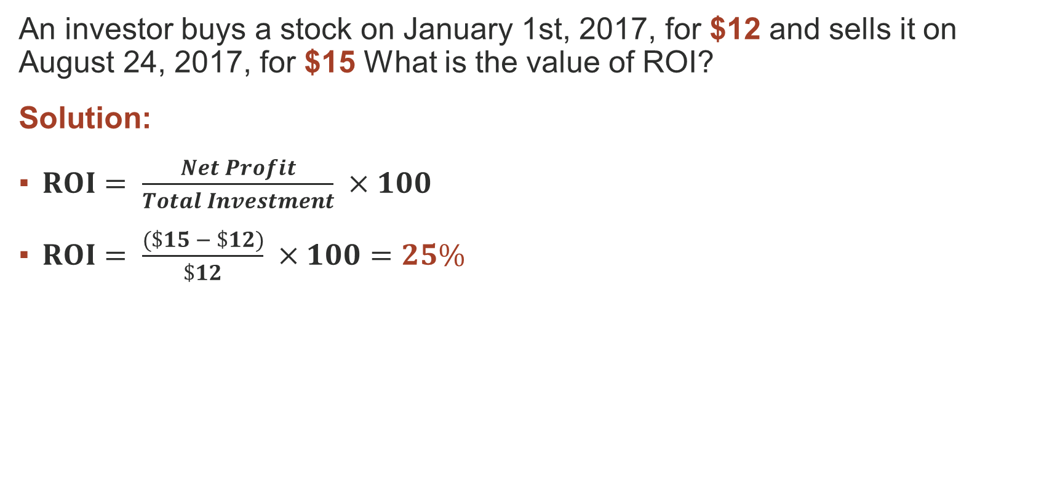
Return on Investment (ROI)
Example 1:
An investor buys a stock on January 1st, 2017, for $12 and sells it on August 24, 2017, for $15 What is the value of ROI?
Solution:
$ROI= \frac{Net Profit}{Total Investment} ×100$
$ROI= \frac{(\$15 − \$12)}{\$12} ×100=25\%$

Slide 14
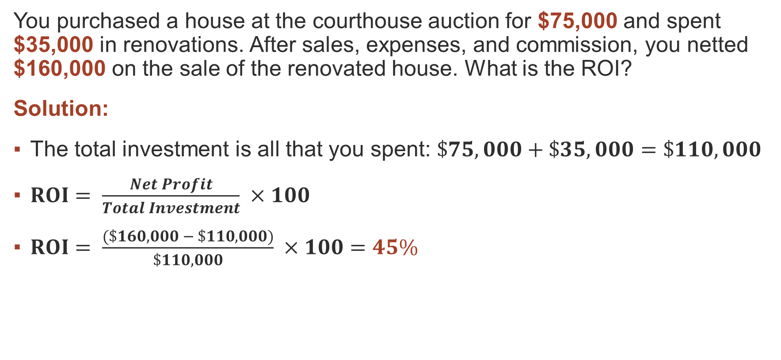
Return on Investment (ROI)
Example 2:
You purchased a house at the courthouse auction for $75,000 and spent $35,000 in renovations. ​After sales, expenses, and commission, you netted $160,000 on the sale of the renovated house. What is the ROI?
​Solution:
The total investment is all that you spent: $\$75,000+\$35,000=\$110,000$
$ROI= \frac{Net Profit}{Total Investment} ×100$
$ROI= \frac{(\$160,000 − \$110,000)}{\$110,000} ×100=45\%$

Slide 15
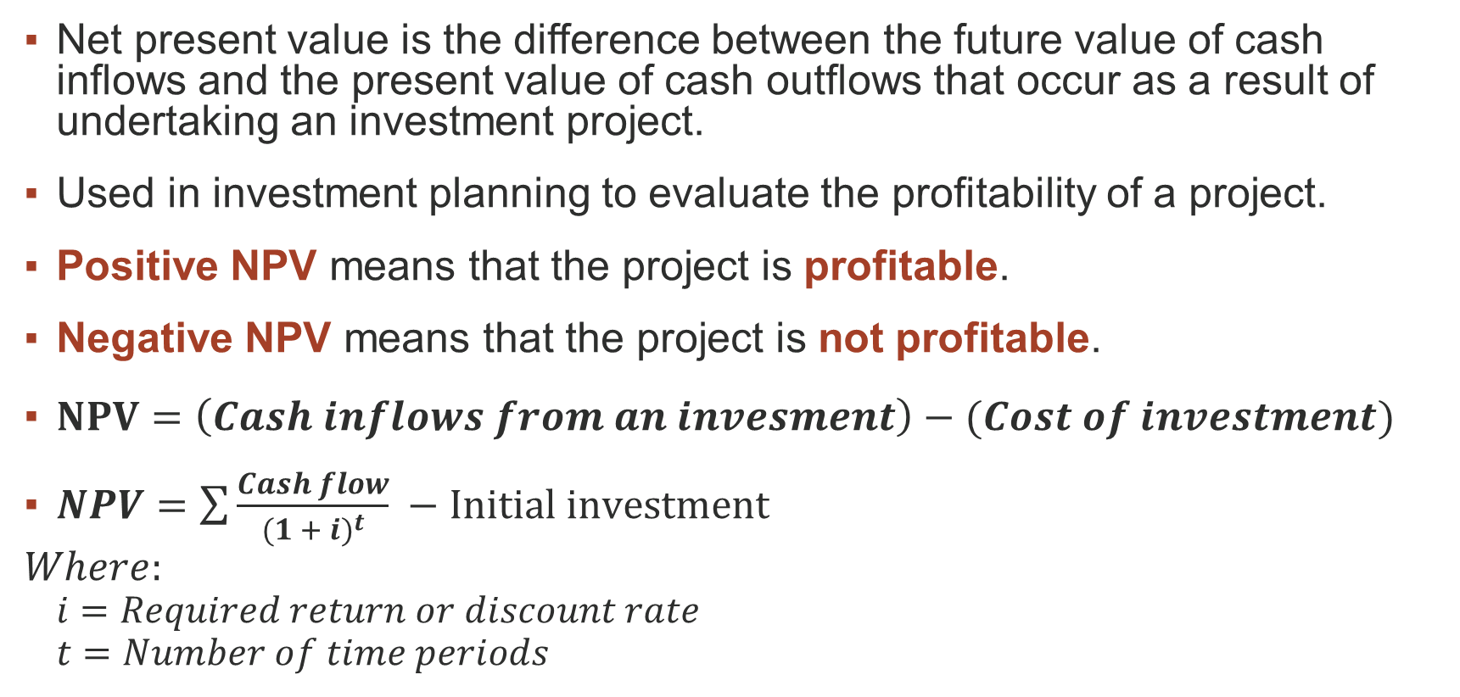
Net Present Value (NPV)
Net present value is the difference between the future value of cash inflows and the present value of cash outflows that occur as a result of undertaking an investment project.
Used in investment planning to evaluate the profitability of a project.
Positive NPV means that the project is profitable.​
Negative NPV means that the project is not profitable.
$NPV=\left(Cash inflows from an invesment\right)−(Cost of investment)$
$NPV=\sum{\frac{Cash flow}{{(1 + i)}^{t}}} −Initial investment$
$$Where:$$
$$i=Required return or discount rate$$
$$t=Number of time periods$$

Slide 16
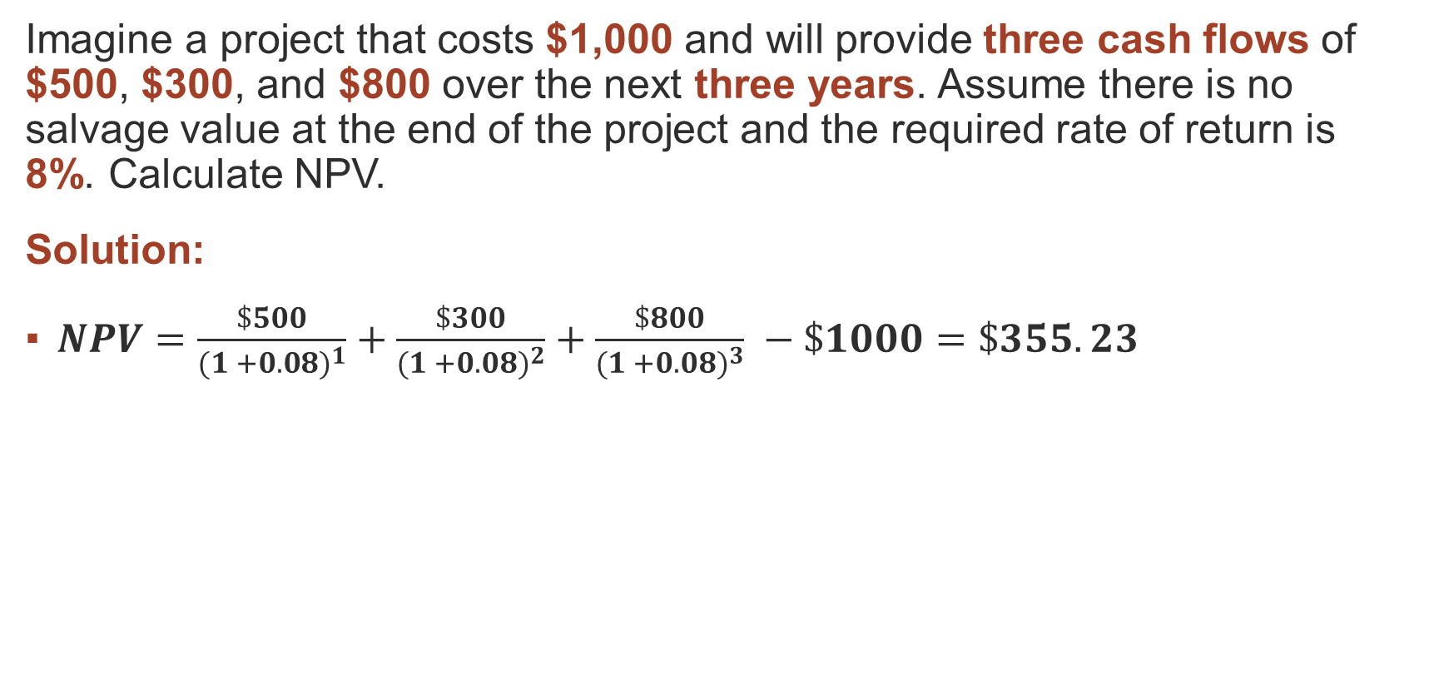
Net Present Value (NPV)
Example 1:
Imagine a project that costs $1,000 and will provide three cash flows of $500, $300, and $800 over the next three years. Assume there is no salvage value at the end of the project and the required rate of return is 8%. ​Calculate NPV.
Solution:
$NPV=\frac{\$500}{{(1 +0.08)}^{1}}+\frac{\$300}{{(1 +0.08)}^{2}}+\frac{\$800}{{(1 +0.08)}^{3}} −\$1000=\$355.23$

Slide 17

Net Present Value (NPV)
Example 2:
Project Y requires a $35,000 initial investment and will generate $27,000 per year for two years. The target rate remains 12%. ​Calculate NPV. ​
Solution:
$NPV=\frac{\$27,000}{{(1 +0.12)}^{1}}+\frac{\$27,000}{{(1 +0.12)}^{2}} −\$35,000=\$10,631$

Slide 18
Thank You

